Slide 1

TEXT FILES AND STREAMS
CREATED BY: D.WEYERS

Slide 2
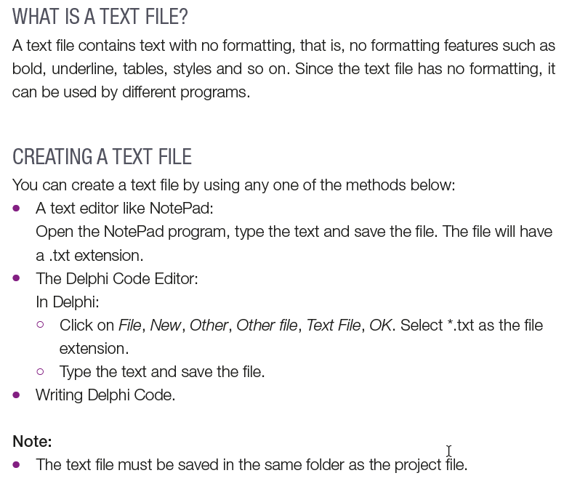
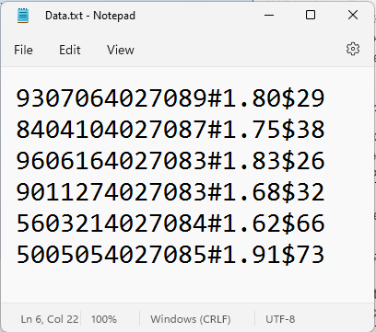
Text file
Procedures used:
AssignFile – assigns file name to file variable Reset – Set focus to start of file; file ready to be read Readln – Reads line of file and stores it in a string variable CloseFile – closes file for reading or writing Append – opens up already created file and places focus at the end of the file to add new text Rewrite – creates new file and sets focus to start of file

Slide 3
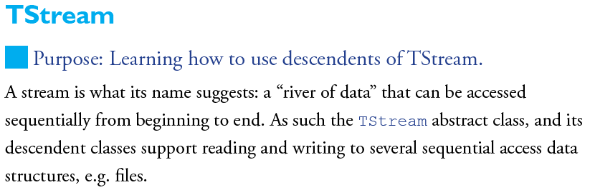

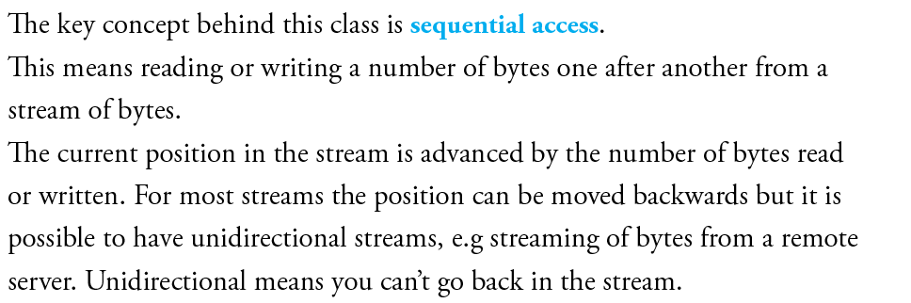
Streams
*How to Program Effectively in Delphi For AS/A Level Computer Science
Kevin R Bond

Slide 4
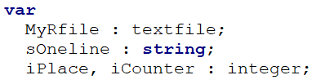
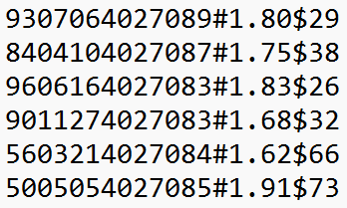
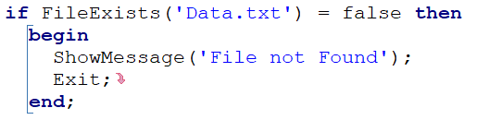

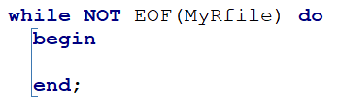

READING FROM A TEXT FILE *ALGORITHM*
Step 1: Declare
Text file:
Step 2: Test
Returns a Boolean value that indicates whether a file with the given path exists or not.
Step 5: Loop
Step 3: Assign
Creates a link between the logical file name and the physical file found on a storage medium.
Step 4: Reset
Opens an existing file for read only access and sets the file pointer at the beginning of the file

Slide 5


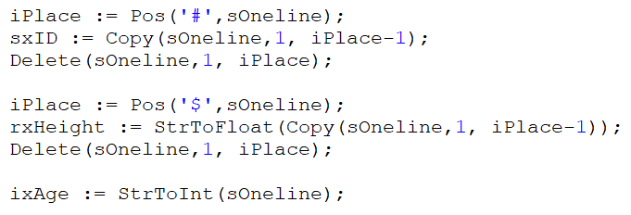

READING FROM A TEXT FILE * ALGORITHM *
Step 6: Read
Reads the selected line of text from the current file pointer position in the file and moves the file pointer to the next line.
Step 7: Extract
7.1
7.2
7.3
7.1
7.2
7.3
Step 8: Process\Display
Step 9: Close
Closes the link between the text file’s logical name and the physical file name. You cannot read or write to the text file once it is closed.

Slide 6
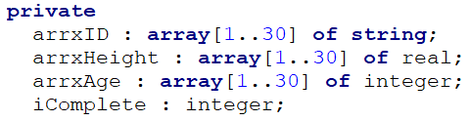
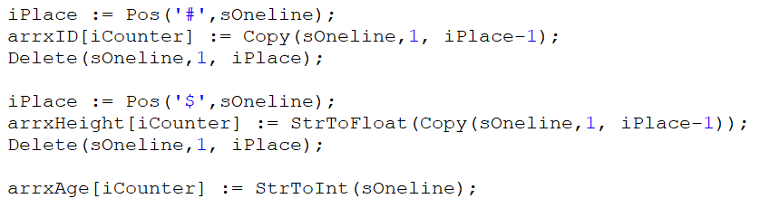

READING FROM A TEXT FILE * ALGORITHM *
Step 6: Read
Step 7: Extract
7.1
7.2
7.3
7.1
7.2
7.3
Step 9: Close
Display out

Slide 7


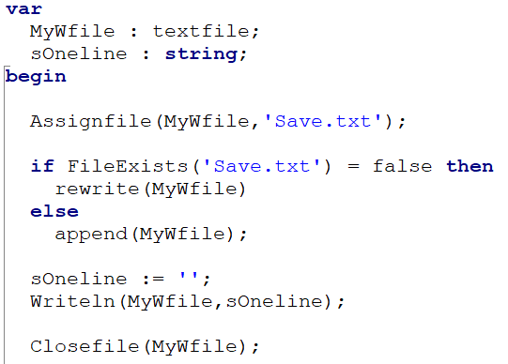
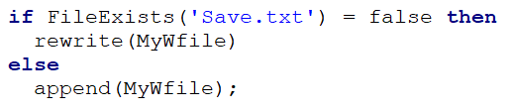

WRITING TO A TEXT FILE * ALGORITHM *
Step 1: Declare
Step 5: Close
Step 2: Assign
Step 3: Test
Create a new file with write only access(writing) and sets the file pointer at the beginning of the file.
Opens the file for writing and sets the file pointer to the end of the file so that text can be written to the end of the text file
Step 4: Write
Writes a line of text at the current position of the file pointer and adds an end-of-line marker after the written text.

Slide 8
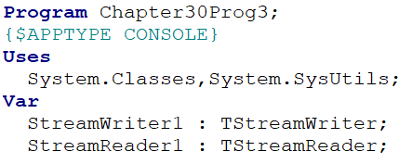
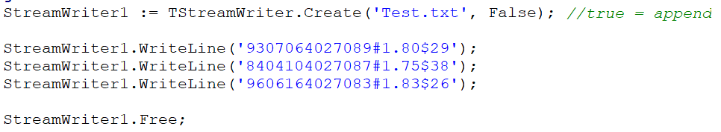
STREAMS WRITE * ALGORITHM *
Step 1: Declare
Step 2: Write

Slide 9
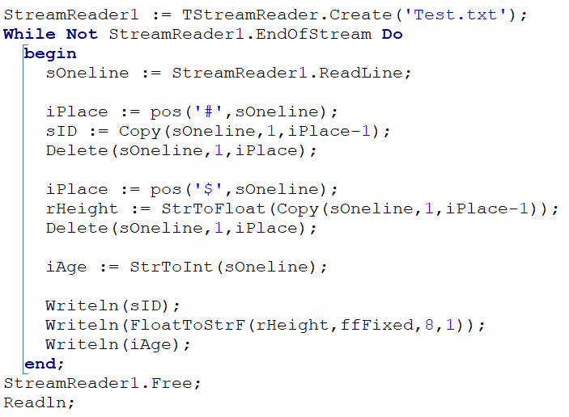
STREAMS READ * ALGORITHM *
Step 1: Declare
Step 2: Read

Slide 10
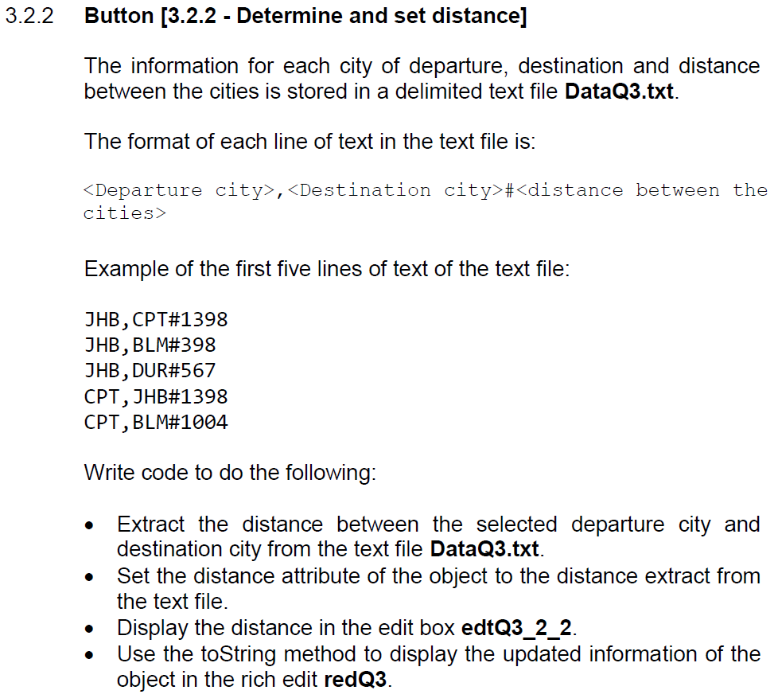
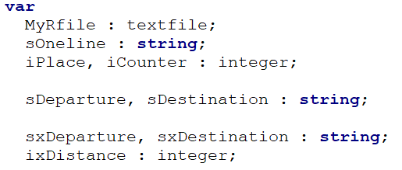
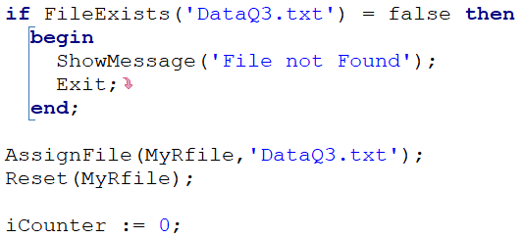
EXAMPLE’S OF TEXT FILE QUESTIONS
Step 1: Declare
Step 2: Test
Step 3: Assign
Step 4: Reset

Slide 11
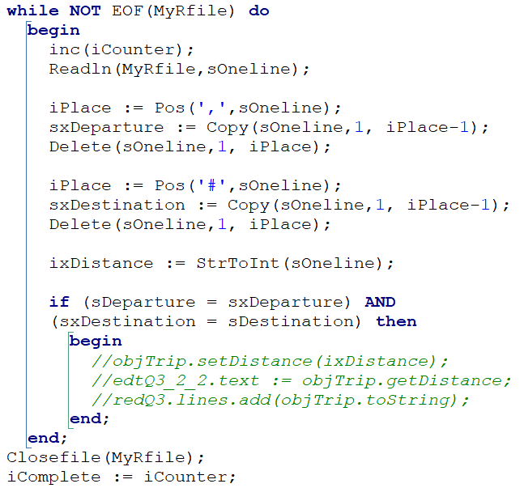
EXAMPLE’S OF TEXT FILE QUESTIONS
Step 5: Loop
Step 6: Read
Step 7: Extract
Step 8: Process
Step 9: Close

Slide 12
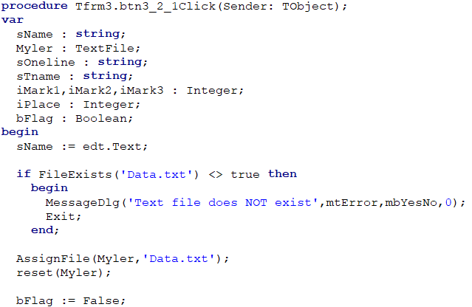
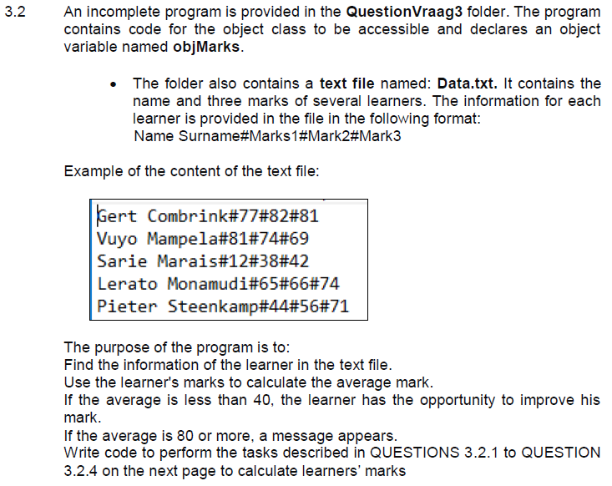
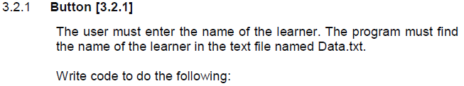
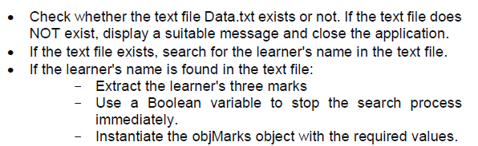
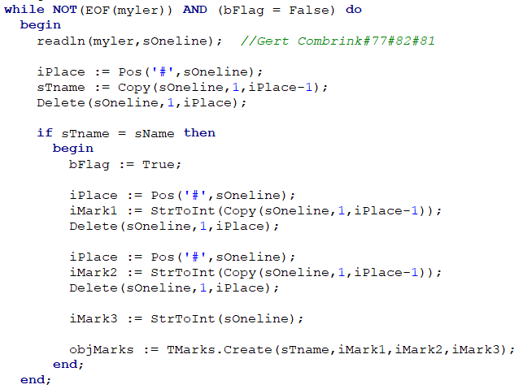

Slide 13
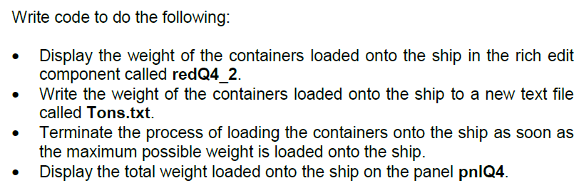

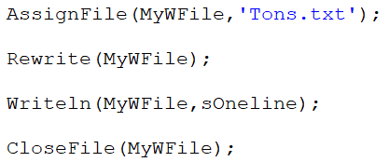
EXAMPLE’S OF TEXT FILE QUESTIONS
Step 1: Declare
Step 2: Assign
Step 3: Test
Step 4: Write
Step 5: Close

Slide 14
THANK YOU
CREATED BY: D.WEYERS

